Slide 1
JavaScript Objects
Web 3

Slide 2
JavaScript Objects
JavaScript is not a full-fledged object-oriented programming language
It does not have stereotypical classes per se
It does not support many of the patterns you’d expect from an object-oriented language like inheritance and polymorphism in a straightforward way
But it provides ways of implementing them

Slide 3
JavaScript Objects
The language does, however, support objects
User-defined objects are declared in a slightly odd way to developers familiar with languages like C++ or Java
the syntax to build pseudo-classes can be challenging
Nonetheless the advantages of encapsulating data and methods into objects outweigh the syntactic hurdle you will have to overcome.

Slide 4
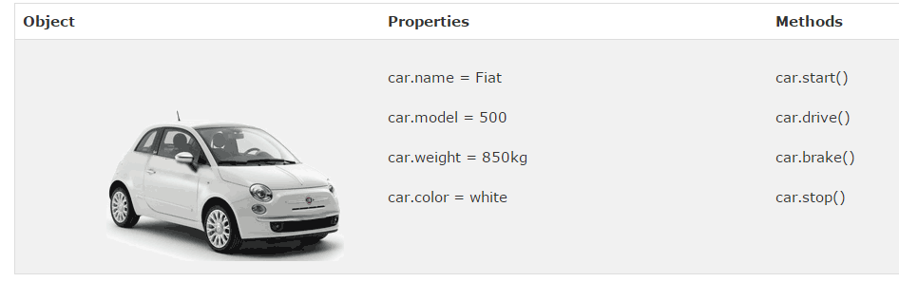
Objects

Slide 5
Properties
Each object might have properties that can be accessed, depending on its definition
When a property exists, it can be accessed using dot notation where a dot between the instance name and the property references that property

Slide 6
Methods
Objects can also have methods, which are functions associated with an instance of an object.
These methods are called using the same dot notation as for properties, but instead of accessing a variable, we are calling a method
Methods may produce different output depending on the object they are associated with because they can utilize the internal properties of the object

Slide 7
Objects included in JavaScript
A number of useful objects are included with JavaScript
These include Array, Boolean, Date, Math, String, and others
JavaScript can also access Document Object Model (DOM) object that correspond to the content of a page’s HTML
The DOM object let JavaScript code access and modify HTML and CSS properties of a page dynamically
The window object in JavaScript corresponds to the browser itself
Through it, you can access the current page’s URL, the browser’s history, and what’s being displayed in the status bar, as well as opening new browser windows.
The alert() function is actually a method of the window object

Slide 8

Math
The Math class allows one to access common mathematic functions and common values quickly in one place.
This static class contains methods such as max(), min(),
pow(), sqrt(), and exp(), and trigonometric functions such as sin(), cos(), and arctan().
In addition, many mathematical constants are defined such as PI, E (Euler’s number), SQRT2, and some others

Slide 9
Strings
The string object is core to communicating with the user
A common need is to get the length of a string
Another common need when working with strings is to concatenate them together. The + operator has been overridden to allow for concatenation in place

Slide 10
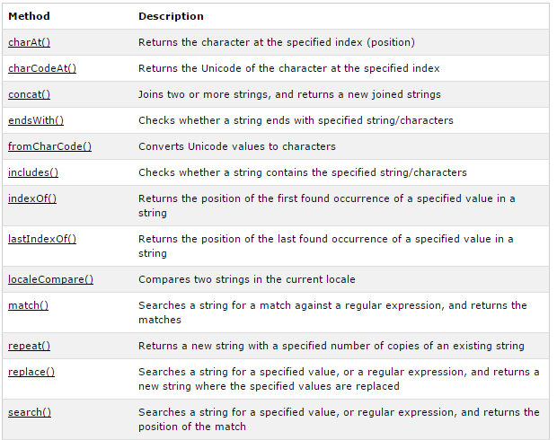
String Methods

Slide 11
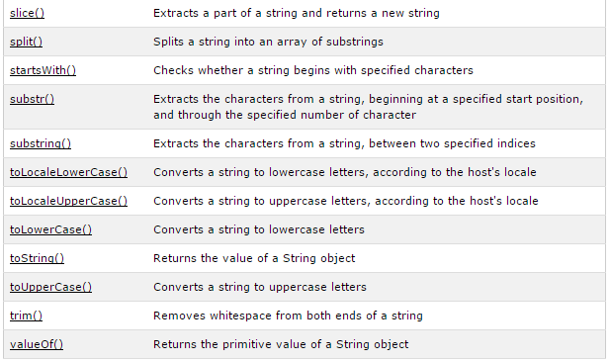
String Methods

Slide 12

Date
The Date object allows you to quickly calculate the current date or create date objects for particular dates.
To display today’s date as a string, we would simply create a new object and use the toString() method

Slide 13
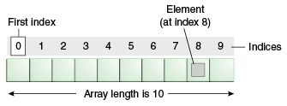
Arrays
Arrays are one of the most used data structures included in JavaScript as well
This class is defined to behave more like a linked list in that it can be resized dynamically, but the implementation is browser specific meaning the efficiency of insert and delete operations is unknown

Slide 14
Arrays
You can initialize an array with 2 different notations:
To access an element in the array you use the familiar square bracket notation
To add an item to an existing array, you can use the push method
Additional methods that modify arrays include concat(), slice(), join(), reverse(), shift(), and sort()

Slide 15

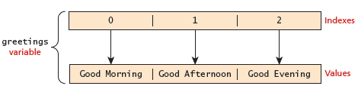
Arrays
One of the most common actions on an array is to traverse through the items sequentially
The following for loop quickly loops through an array, accessing the i^{th} element each time using the Array object’s length property to determine the maximum valid index

Slide 16
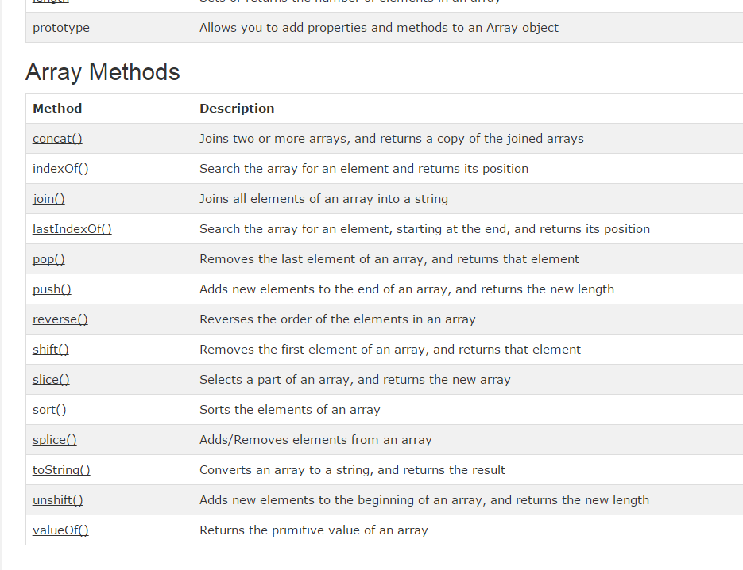

Slide 17
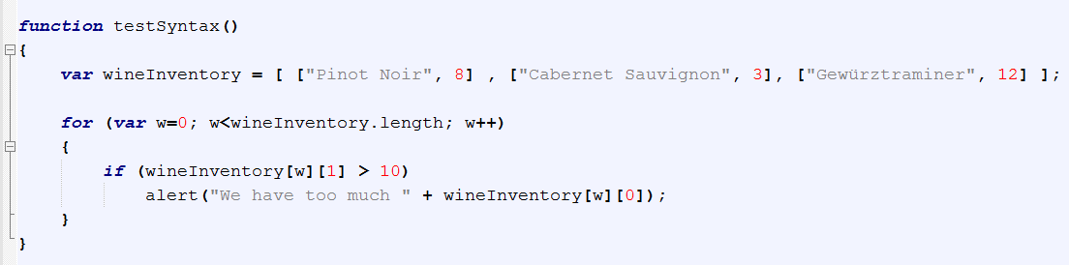
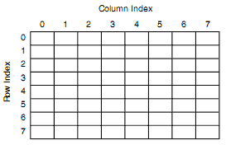
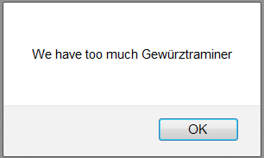
2D Arrays

Slide 18
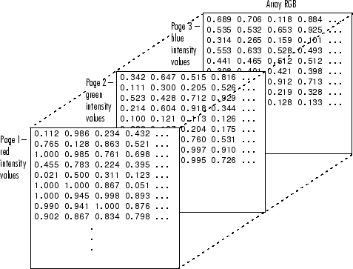
3D Arrays

Slide 19
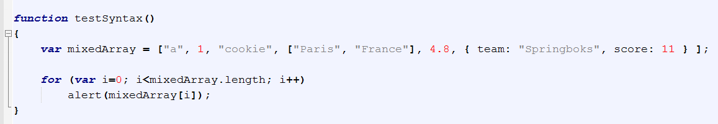
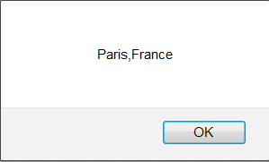
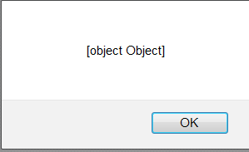
Arrays containing multiple types

Slide 20
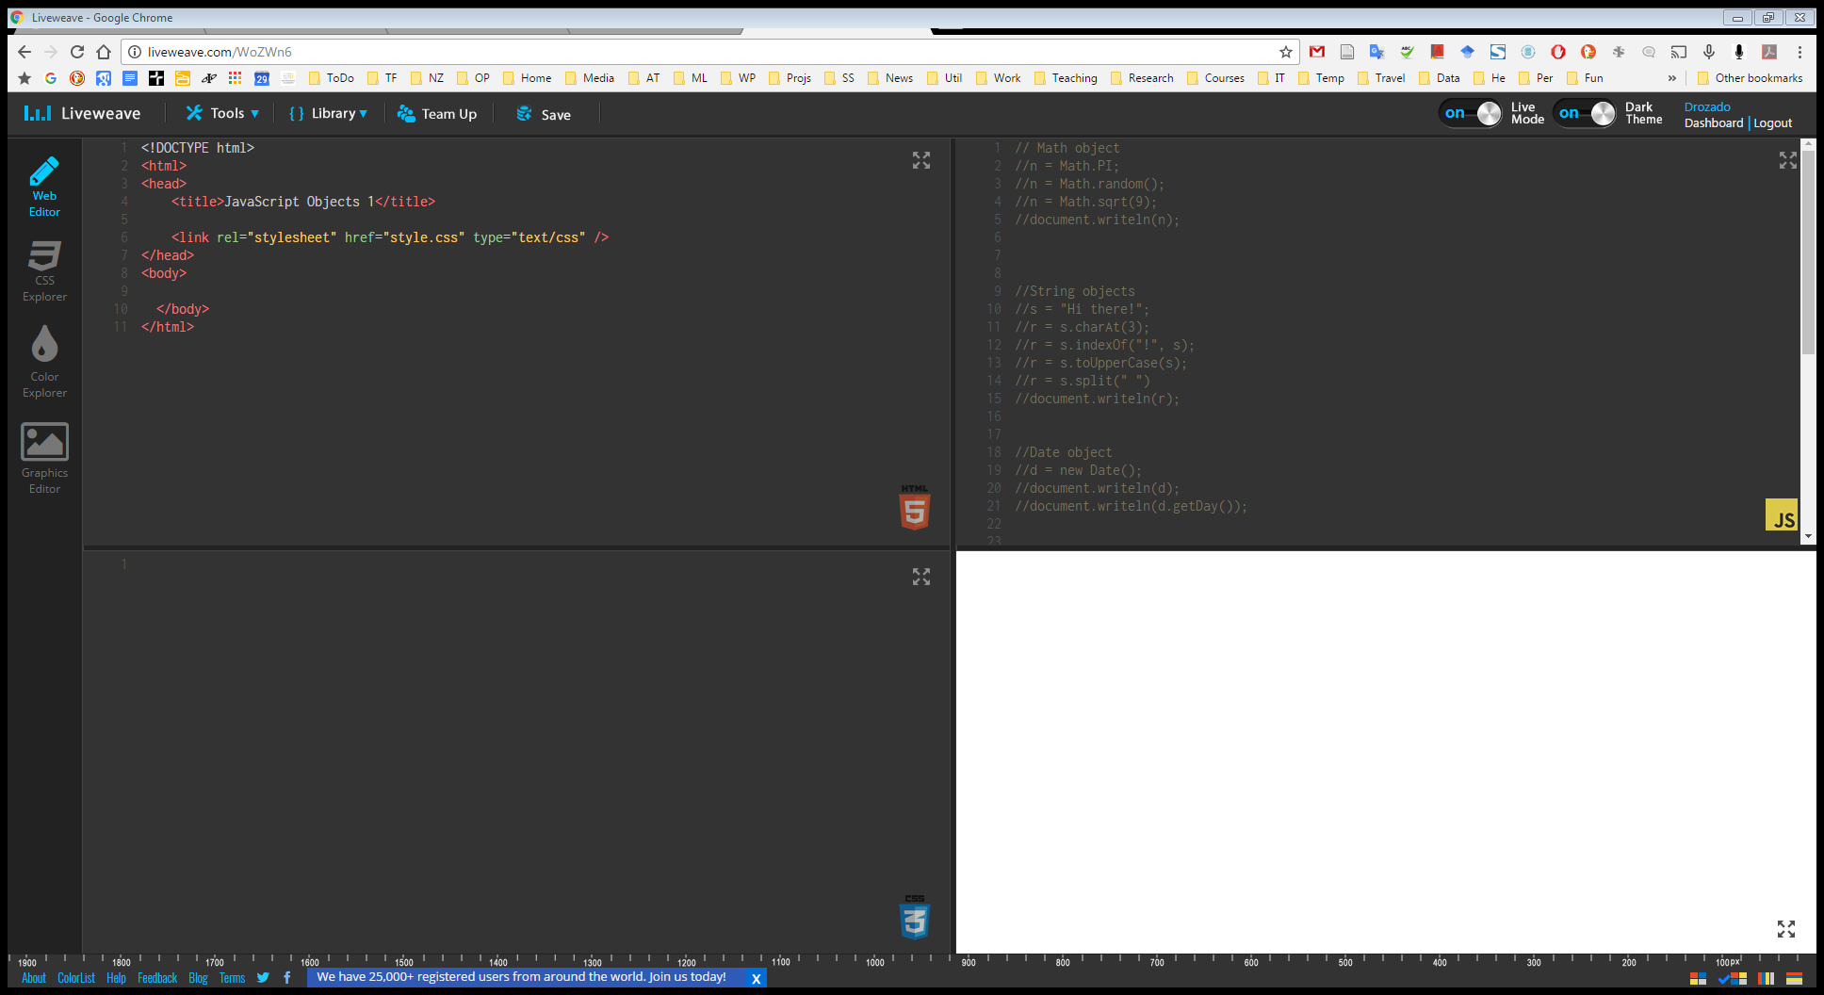
Demo

Slide 21
Higher order functions

Slide 22
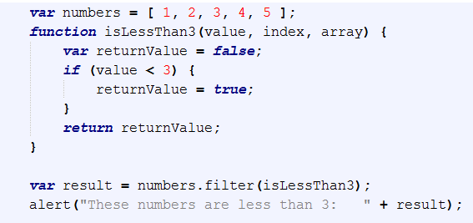
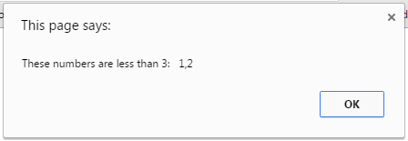
Iterating through an array without loops - filter

Slide 23
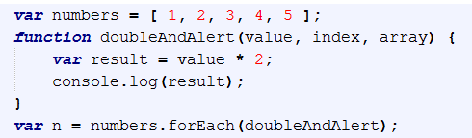
Iterating through an array without loops –forEach

Slide 24
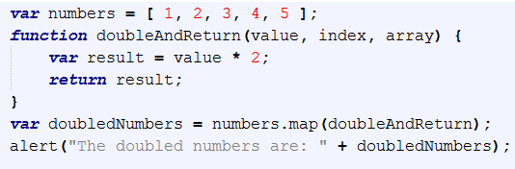
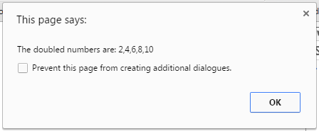
Iterating through an array without loops –map

Slide 25

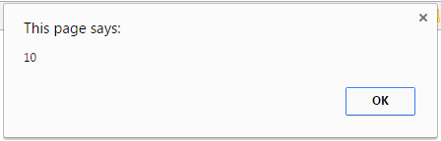
Iterating through an array without loops –reduce
Another common pattern of computation on arrays is computing a single value from them.
A recurring example is summing a collection of numbers
You can think of it as folding up the array, one element at a time.
When summing numbers, you’d start with the number zero and, for each element, combine it with the current sum by adding the two.
The parameters to the reduce function are, apart from the array, a combining function and a start value.

Slide 26
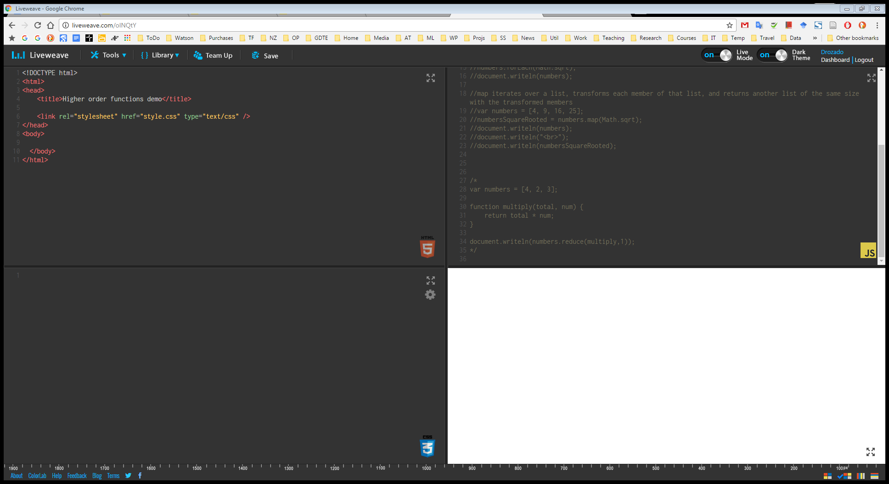
Higher order functions demo

Slide 27


Instantiating your own Objects in JS
You can initialize an object with 2 different notations:
Notes:
An object is a hard shell that hides the gooey complexity inside it and instead offers us a few knobs and connectors (such as methods) that present an interface through which the object is to be used.
The idea is that the interface is relatively simple and all the complex things going on inside the object can be ignored when working with it.

Slide 28
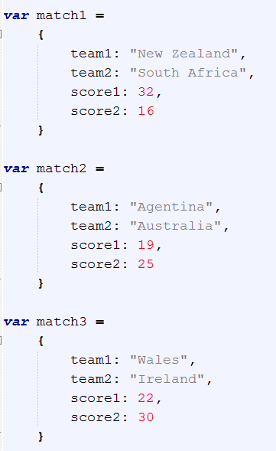
Creating multiple instances of an object
How do we create multiple instances of objects?
Here is one approach. When objects are created like this, they are called “object literals”.
But this gets to be a huge pain.
Coming from an OO perspective, what would you really like to have here? => A constructor.
Even though we haven’t defined a class (it doesn’t work quite like that in JavaScript), we’d still like to have a template method for creating instances of a particular object type (the logical equivalent of a constructor).

Slide 29
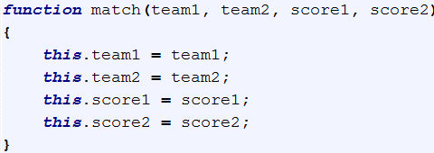
Javascript Constructors
Normally to create a new object we use the new keyword, the class name, and ( ) brackets with n optional parameters inside, comma delimited
Any function in JavaScript can be used to create custom object classes, simply by calling it using the keyword new
Unlike C++ or C#, you don’t have to predeclare the fields and methods your object will hold. You just write the constructor.
If you forget the new keyword it expects an ordinary function with a return. Since you don’t have return anything, matchInstance is simply undefined after the call
new tells the interpreter to create a new object in memory, who is this inside the function, and to return a reference to that new object
the special variable this inside the function references the new object that is being constructed (it normally refers to the 'current' object)
this is similar to Python’s self or Java’s this

Slide 30
Creating objects in Javascript
For some classes, shortcut constructors are defined (aka literal), which can be confusing if we are not aware of them.
var greeting = new String("Good Morning!")
var greeting = "Good Morning!"
//-------------------
var cars = new Array("Saab", "Volvo", "BMW");
var cars = ["Saab", "Volvo", "BMW"];
//-------------------
var person = new Object();
person.firstName = "John";
person.lastName = "Doe";
person.age = 50;
person.eyeColor = "blue";
var person = {firstName:"John", lastName:"Doe", age:50, eyeColor:"blue"};

Slide 31
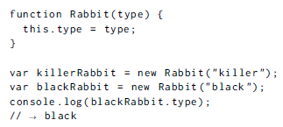
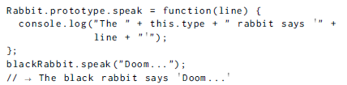
Prototypes
In addition to their set of properties, almost all objects also have a prototype.
A prototype is another object that is used as a fallback source of properties.
When an object gets a request for a property that it does not have, its prototype will be searched for the property
Prototypes are computationally efficient
Constructors automatically get a property named prototype, which by default holds a plain, empty object that derives from Object.prototype. Every instance created with this constructor will have this object as its prototype. So to add a speak method to rabbits created with the Rabbit constructor, we can simply do this:

Slide 32
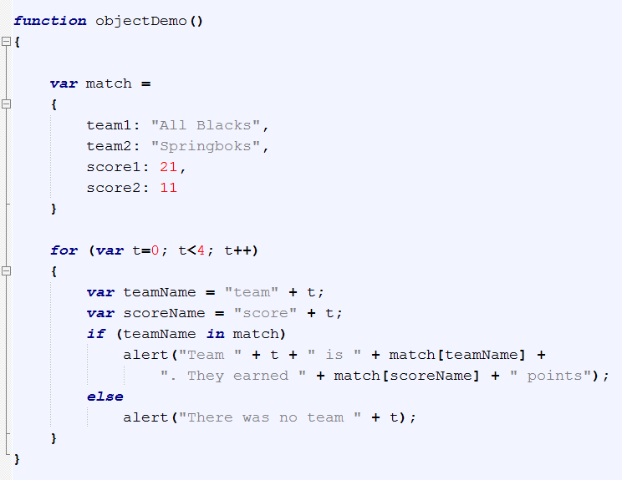
The in operator
It tests membership of a field (by field name) in an object via the key part of the key:value pairs
“If the object match contains a field called team1”

Slide 33
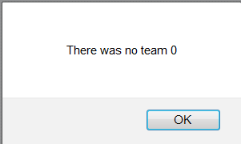
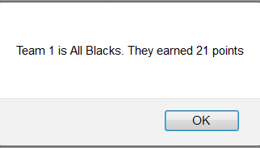
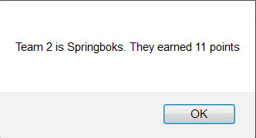
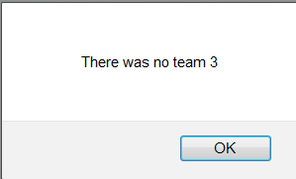
Objects
The in operator

Slide 34
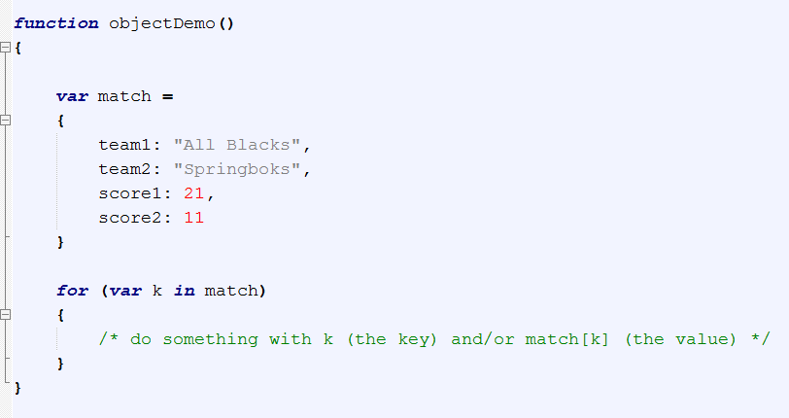
Objects
The in operator
The in operator can be used to iterate over all the elements of an object.
In this usage, k will take on each key (field name) in the object, in sequence.
Sort of like a foreach loop in C#, but for keys instead of for elements in a collection.
In this case, k will take on the values “team1”, “team2”, “score1”, “score2”, in that order, and can be used exactly like string literals.

Slide 35
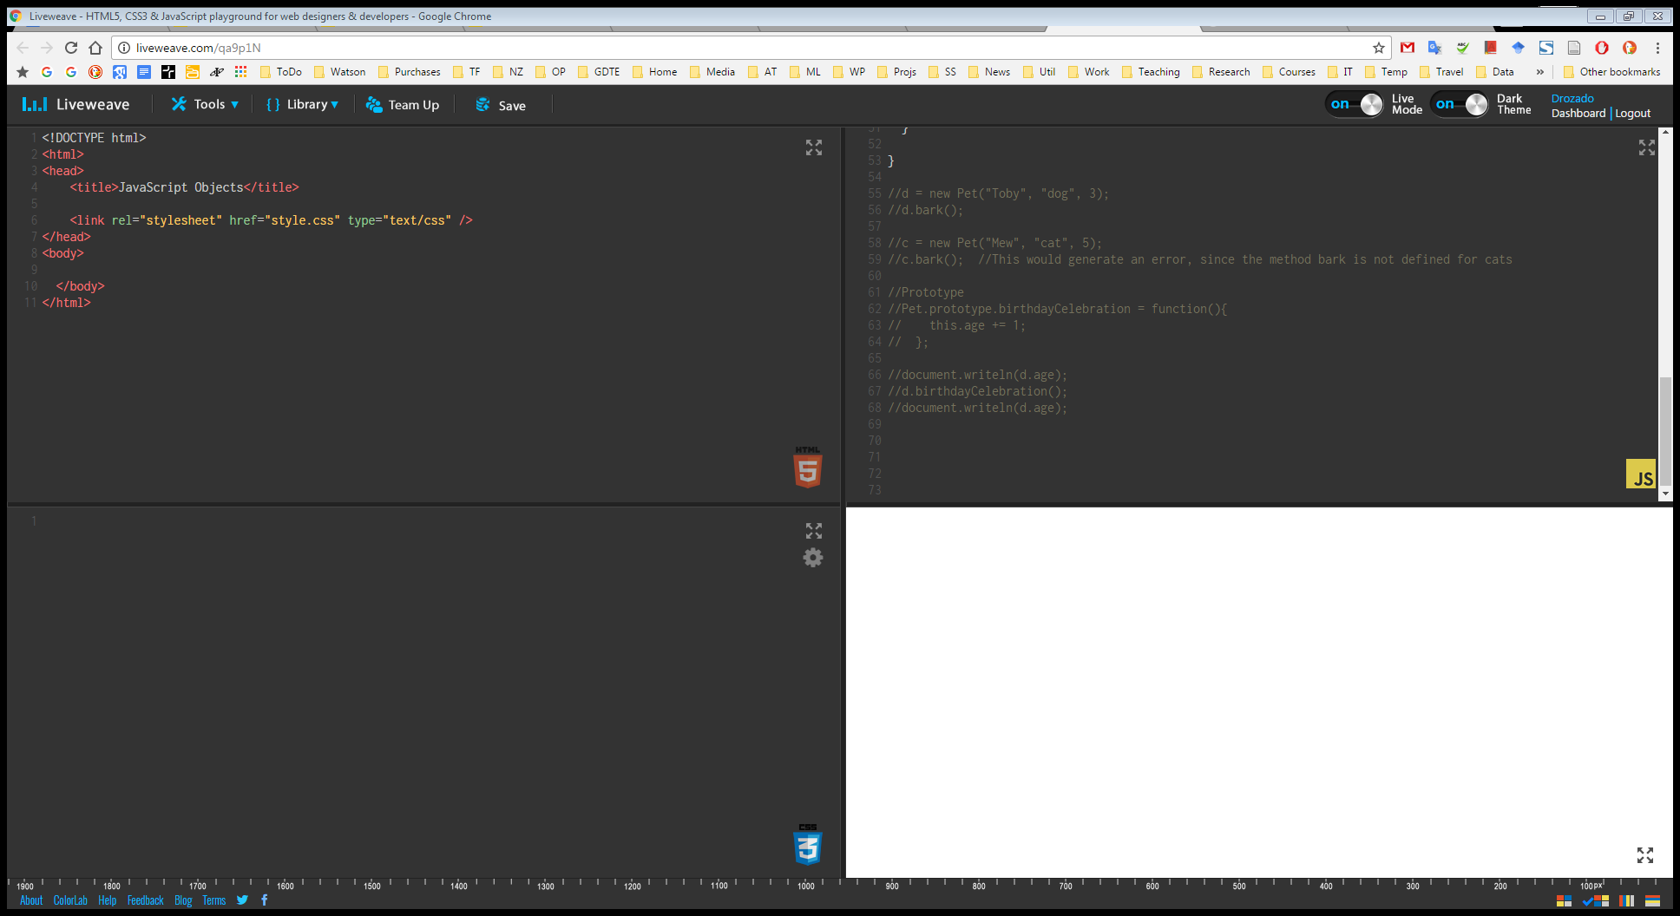
Objects Demo

